Slide 1
Mathematics For Computing Sigma Notation
www.Stats-Lab.com

Slide 2
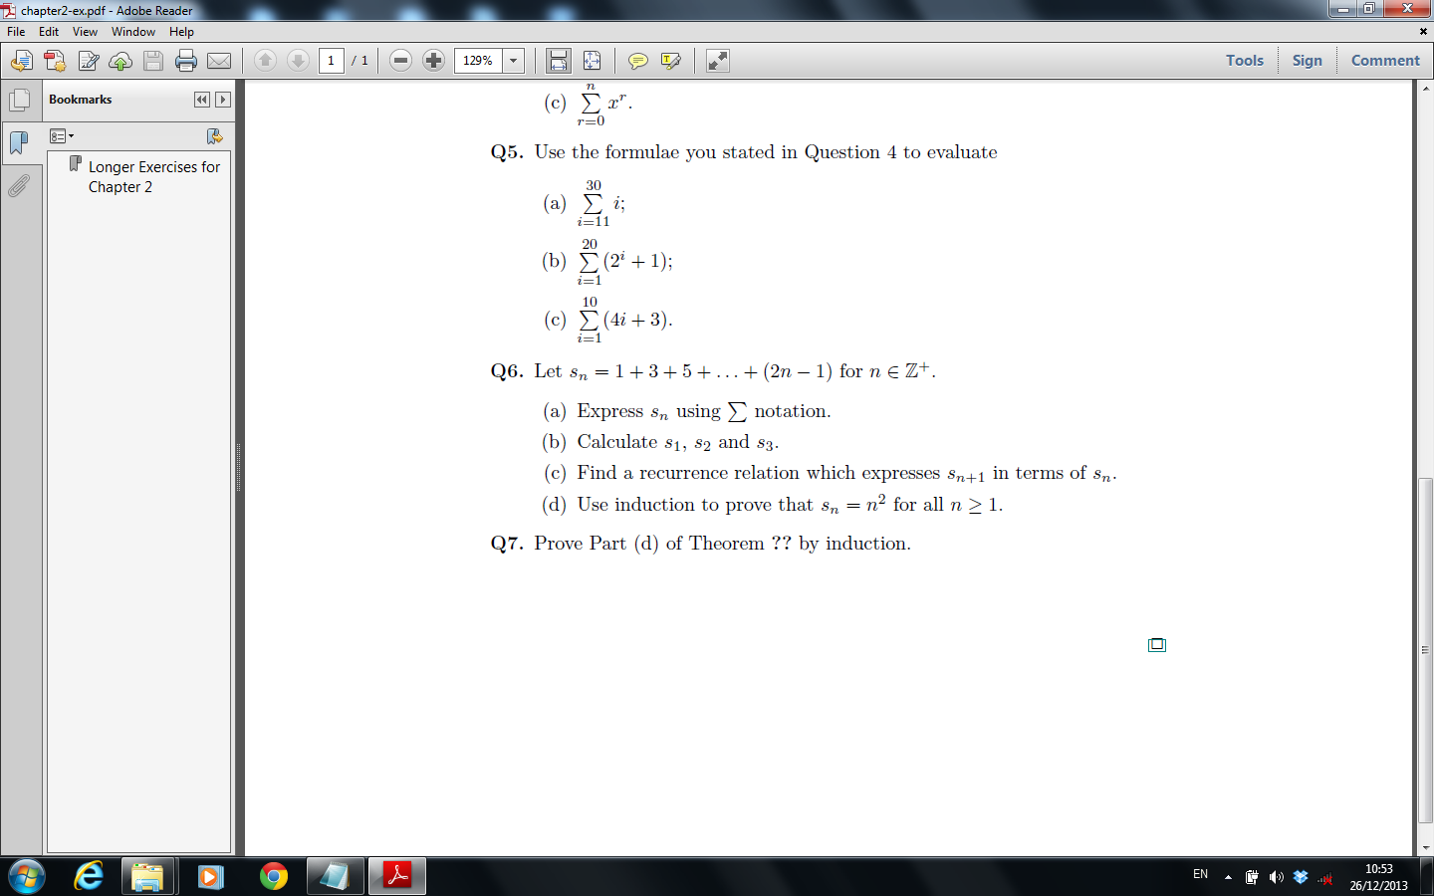
Sigma Notation

Slide 3
Sigma Notation

Slide 4
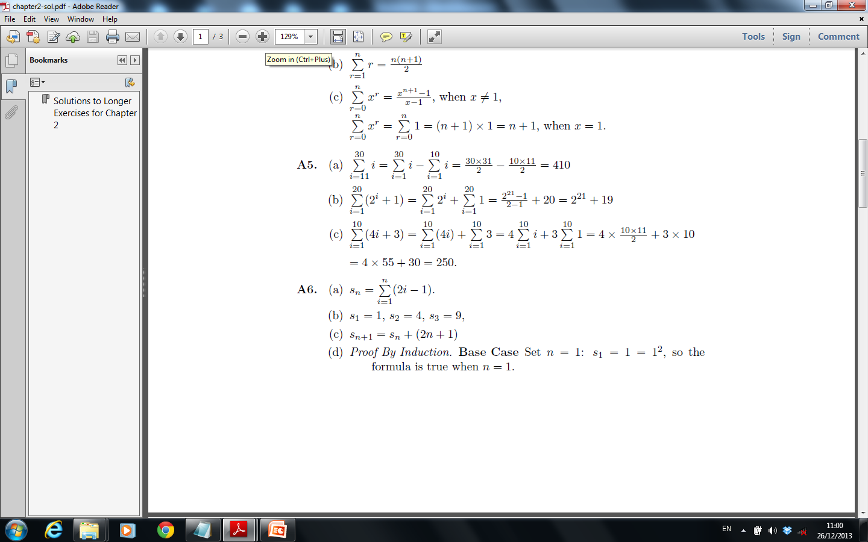
Sigma Notation

Slide 5
Sigma Notation

Slide 6
Sigma Notation

Slide 7
Sigma Notation

Slide 8
Sigma Notation

Slide 9
Sigma Notation

